Slide 1
Project 4 Supply Chain Management
By Aaditya Mahindrakar
aadmahindrakar007@gmail.com

Slide 2
Index
Problem Statement
Proposed System
Data Understanding & Exploration
Data Cleaning
Data Preparation
Model Building & Evaluation.
Conclusion

Slide 3
Problem statement An FMCG company entered into the instant noodles business two years back. Their higher management has noticed that there is a miss match in the demand and supply. Where the demand is high, supply is pretty low and where the demand is low, supply is pretty high. In both ways, it is an inventory cost loss to the company; hence, the higher management wants to optimize the supply quantity in every warehouse in the entire country.
Objective
This exercise aims to build a model, using historical data that will determine the optimum weight of the product to be shipped each time to the warehouse.
Also, try to analyze the demand pattern in different pockets of the country so management can drive the advertisement campaign, particularly in those pockets.
This is the first phase of the agreement; hence, the company has shared very limited information. Once you are able to showcase a tangible impact with this much information then the company will open the 360-degree data lake for your consulting company to build a more robust model.
Let’s see the data..

Slide 4
Proposed System
Data
Data preprocessing
Transformation
Feature Scaling
Training Data
Testing Data
Regression Model
New Data
Model Training
Regression Output

Slide 5
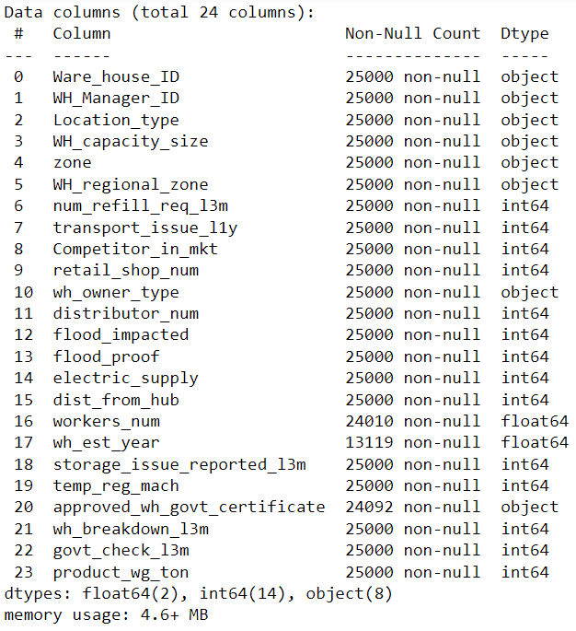
Data Understanding & Exploration
By the information from the data we can clearly see that there are some missing values in variables.
We need to check for the outliers before handling missing values.
There are 8 ‘object’ data type variables.
wh_est_year: Warehouse established year is missing 47 % values therefore it’s not contributing much in model building. Better to drop this variable.

Slide 6
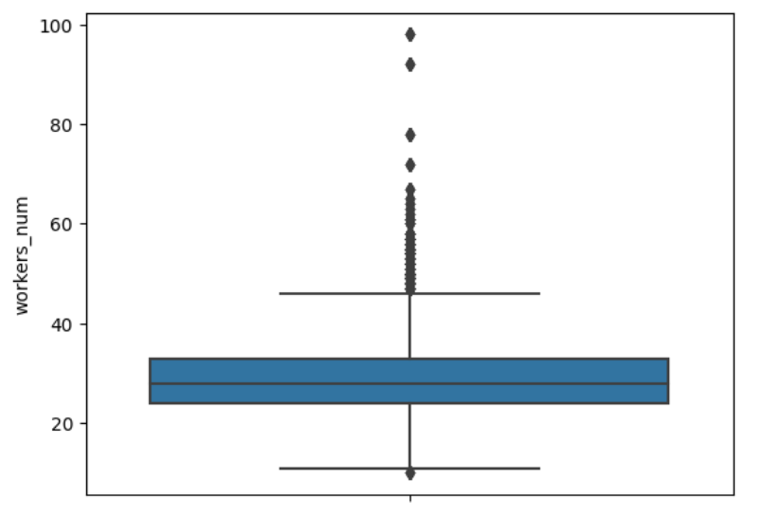
Handling Missing values
While handling missing values of the variable, there are some outliers in them, we need to use median approach to fill them.
And for the categorical variables we are using mode approach.

Slide 7
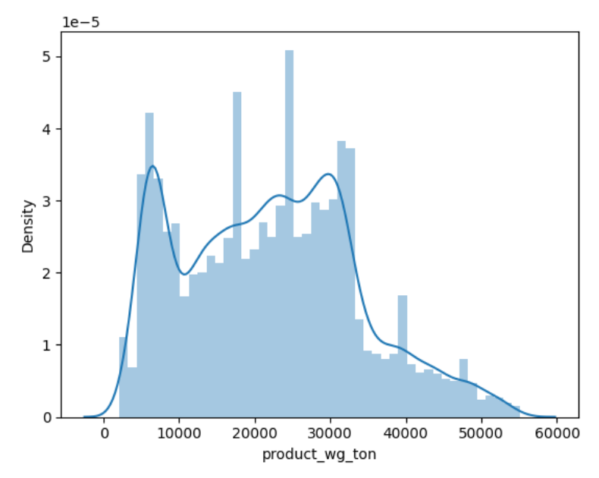
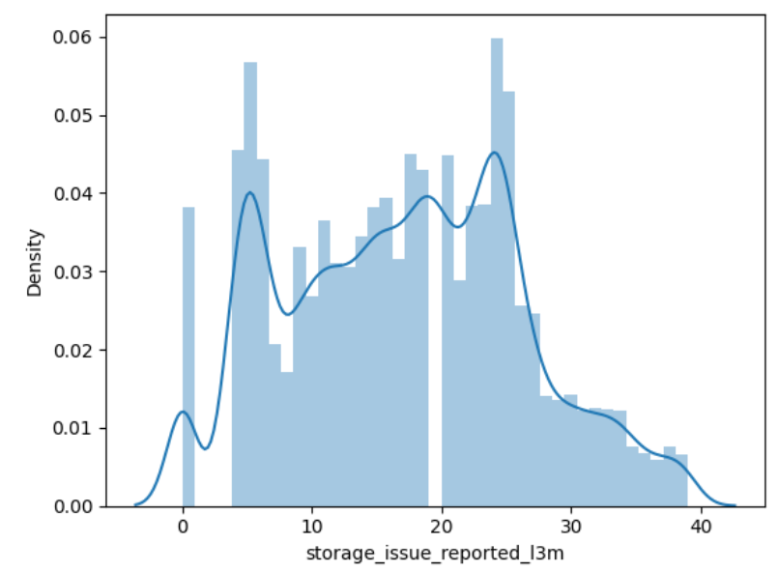
Distribution plot of Target variable 'product_wg_ton' and 'storage_issue_reported_l3m' are almost identical

Slide 8
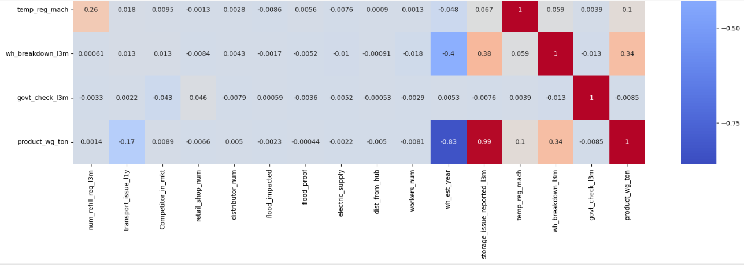
From the all the numeric features of the dataset, 'storage_issue_reported_l3m': Storage Issue Reported in last 3 moths variable is highly correlated with the target variable.
The Problem Statement gives the information that, the management has noticed that there is a mis match in demand and supply. Where demand is high, supply is pretty low and where the demand is low, supply is pretty high.
By the problem statement and the analysis of the data (heatmap) we can say that, feature 'storage_issue_reported_l3m' inversly proportional to the target variable 'product_wg_ton’.
Inverse transformation approuch is suitable for this scenario. R squared moght be very low but the model will be reliable.

Slide 9
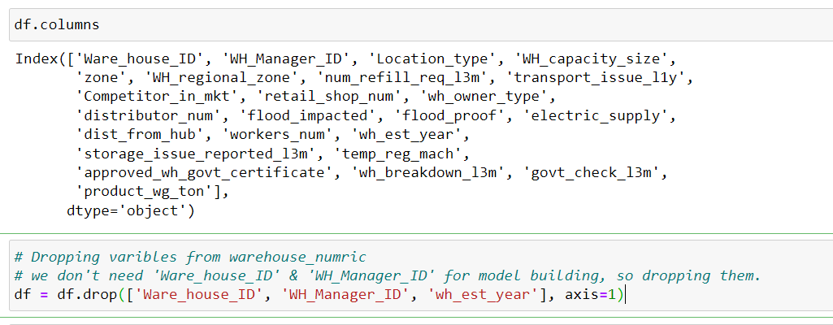
Data Cleaning
The second step in model building is data cleaning.
We need to drop variable 'wh_est_year' because of missing 47% of the data.
We don't need 'Ware_house_ID' & 'WH_Manager_ID' for model building, so dropping them.

Slide 10
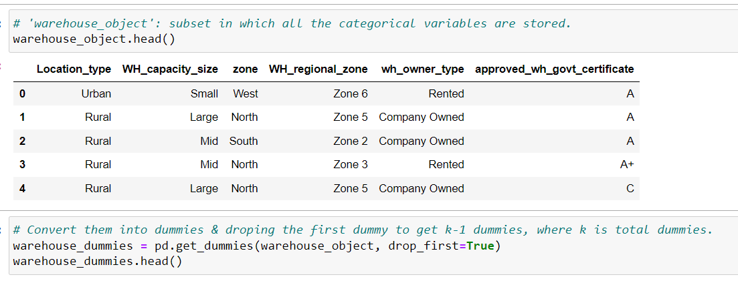
Data Preparation
We have created a subset of data, warehouse object ,
In warehouse object there are categorical variables for which we cannot directly convert to numerical types, So we can make use of get_dummies of pandas to suitable dummies for different levels of variables.
Lets now create dummy variables for categorical variables.¶

Slide 11
Model Building & Evaluation
The 4th and important step in machine learning is Model Building & Evaluating it.
The first step in model building is usual train test split.

Slide 12
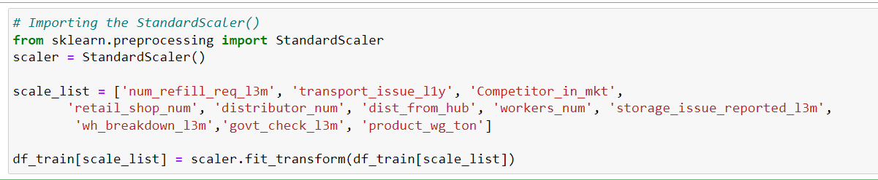
Feature Scaling
Now we have done the train-test split, we need to scale the variable for better interpretability and for handling the outliers. But we only need to scale the numeric columns & not the dummy variables. Lets take a look at the list of numeric variables we had created in the beginning.
Also the scaling has to be done only on the train dataset as you don’t want the model to learn anything from the test data.
'flood_impacted', 'flood_proof','electric_supply','temp_reg_mach' : These are binary categorical variables. 'wh_est_year', : We have already eliminated these variables.¶

Slide 13
Transformation
Performing inverse transformation on the ‘storage_issue_reported_l3m’ to get maximum values to minimum values.
By this transformation we can eliminate the supply & demand mismatch.

Slide 14
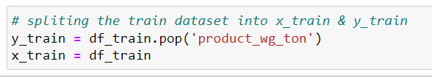
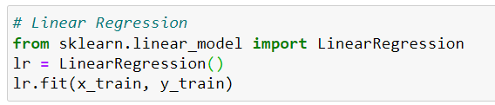
Regression Model building
Now the variables are appropriately scaled. We need to divide the data into dependent & independent variables.
And Building Linear Regression model on all the features

Slide 15
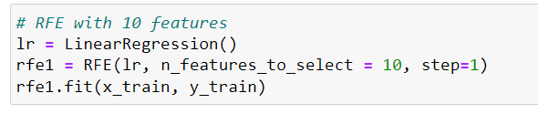
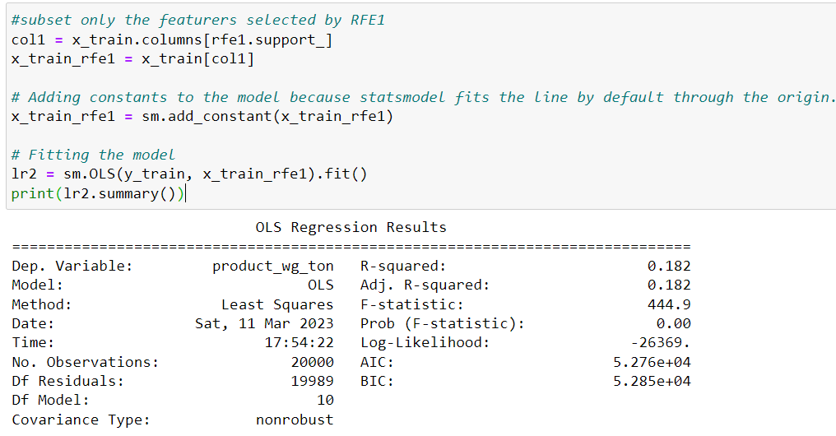
Recursive Feature Elimination (RFE)

Slide 16
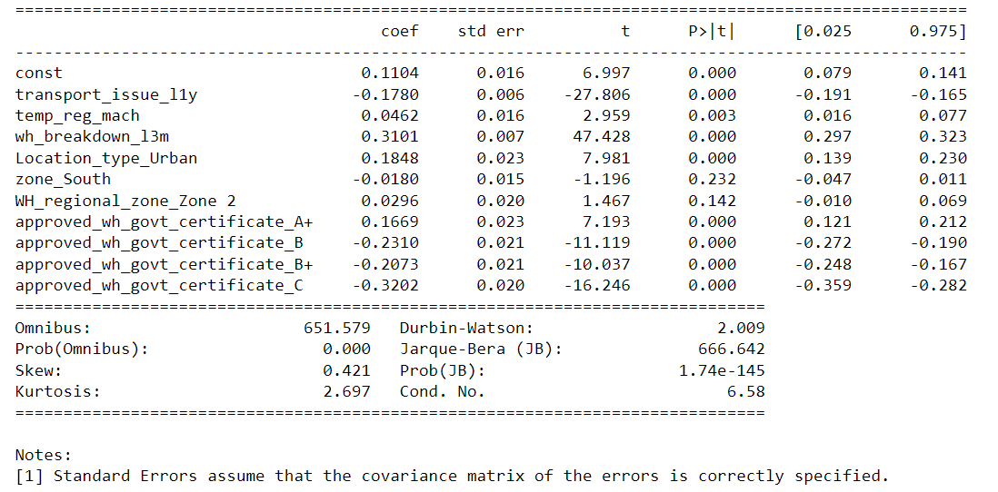
Because we have taken reciprocal of our most significant variable 'storage_issue_reported_l3m' , R squared has become very less.
But we intend to solve supply and demand issue this model good. lets see how our model performance with even less features.

Slide 17
'zone_South’ , 'WH_regional_zone_Zone 2’ have p values more than 0.05, lets drop them one by one.

Slide 18
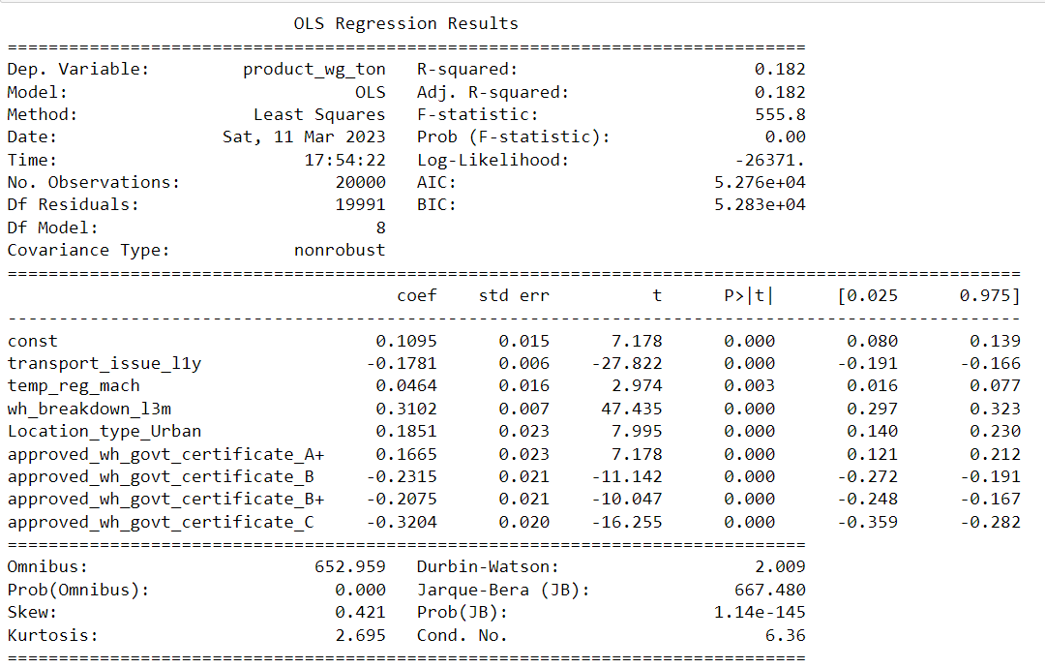
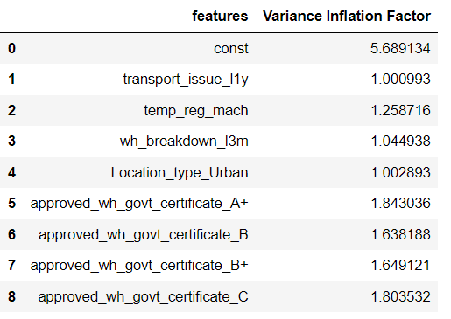
'zone_South’ , 'WH_regional_zone_Zone 2’ have p values more than 0.05, lets drop them one by one.
And Check VIF (Variance Inflation Factor)

Slide 19
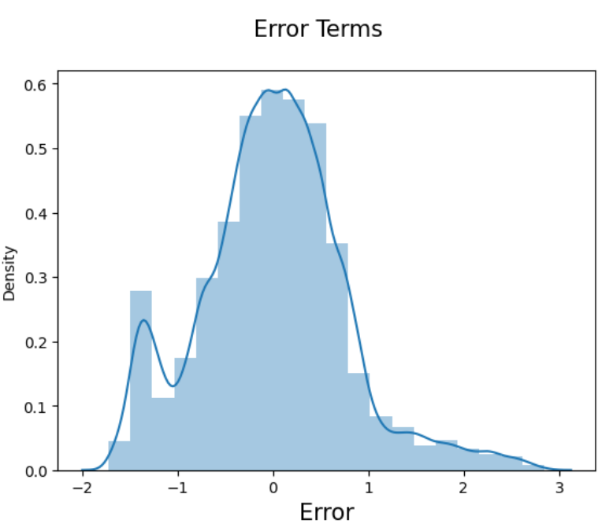
Residual Analysis
After removing variables R squared has remained same. All the VIF (<5) and P values (0.05) seems to be in good range.
Residual Analysis
Before we make the predictions on the test data we need check the actual accuracy,. Residual Analysis

Slide 20
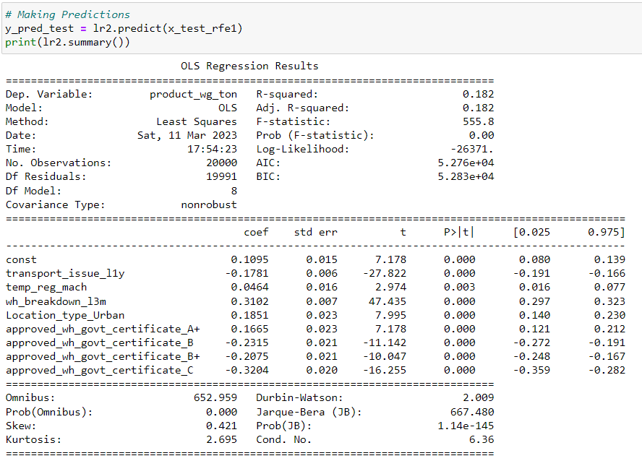
Making Prediction
We would first need to scale the test set as well using only transform but not using fit_transform, so that the model will not learn about the data

Slide 21
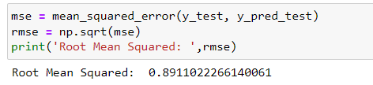
Errors

Slide 22
Conclusion
Thus, for the model with only 8 variables the r squared & Adjusted r squared on training & test data is about 0.182
But the higher management has noticed that the supply and demand has mismatched.
'storage_issue_reported_l3m' : storage issue reported in last 3 months, this feature highly significant. And we have taken inverse of the feature,
Therefore the model now might look as having bad accuracy.
The model will overcome the supply and demand mismatch, for now.
We have seen that there are very weak correlation to the target variable 'product_wg_tons.
Retraining the model for future data is necessary. By having 360 degrees of data a model can give more accurate predictions in future.

